Slide 1

ESD Management.
Electro Static Discharge (ESD) notions, prevention and general information.

Slide 2
01
What is ESD?
02
Why is ESD important to SL?
03
ESD Control/Protection/Maintenance
04
Identifying ESD daily at work
CONTENTS

Slide 3


01
What is ESD?
Electro Static Discharges are everywhere.
An electrostatic discharge (ESD), commonly known as “Zap” is the sudden transfer of static charge between bodies at different charge potentials caused by near contact or induced by an electric field. Some examples of ESD events would be hair attracted to static electricity or a minor electric shock when touching metallic surfaces while wearing wool or plastic fabric clothing.

Slide 4
02
Why is ESD important to SL?
Why should we be careful with our processes.

Slide 5
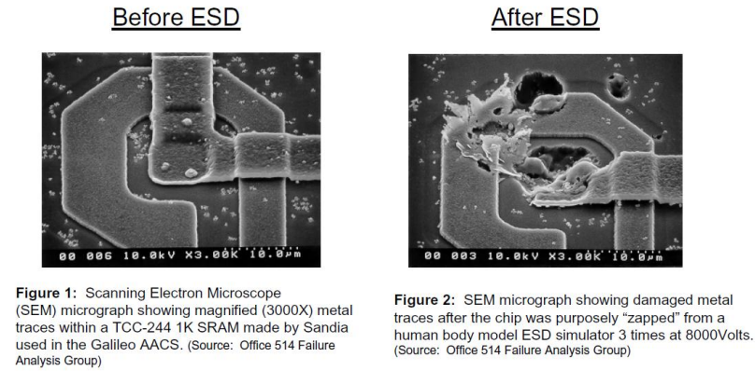




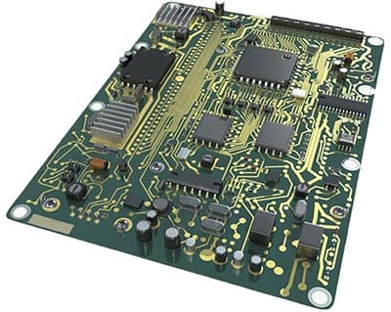
Why does ESD matter to SL Alabama?
A lack of ESD control can lead to electronic parts being “zapped” which means:
Failed/destroyed parts (this could lead to rework or excess scrap). The ESD event may have caused a metal melt, junction breakdown or oxide failure.
Increased costs
Wasted time and missed deadlines
A dead car lamp and an unhappy/unsafe customer
An easy to remember analogy would be a lightning striking a tree compared to an ESD shocking a Printed Circuit Board (PCB)
≈
Important: Most functional defects on field (customer compliance) occur because of poor ESD control (latent failure) which means that it may continue to perform its intended function, so may not be detected by normal inspection. However, intermittent or permanent failures may occur at a later time. Catastrophic damage can be fixed/solved during an early inspection stage.

Slide 6
03
ESD Control/Protection/Maintenance
How can we prevent our components from being damaged?

Slide 7
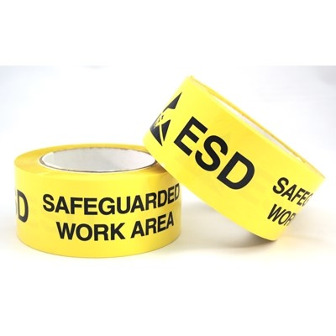

ESD Control: ESD Protected Areas (EPA)
– Only conduct electrical work in these designated areas
All ESD control procedures must be followed in all areas marked with any of the following:
ESD Protective Symbol EPA Marking Tape

Slide 8
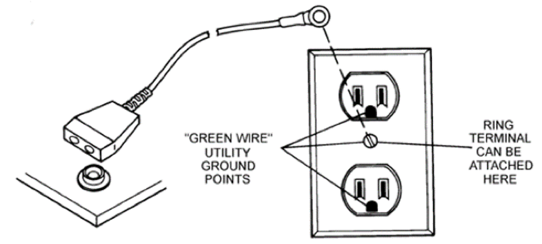
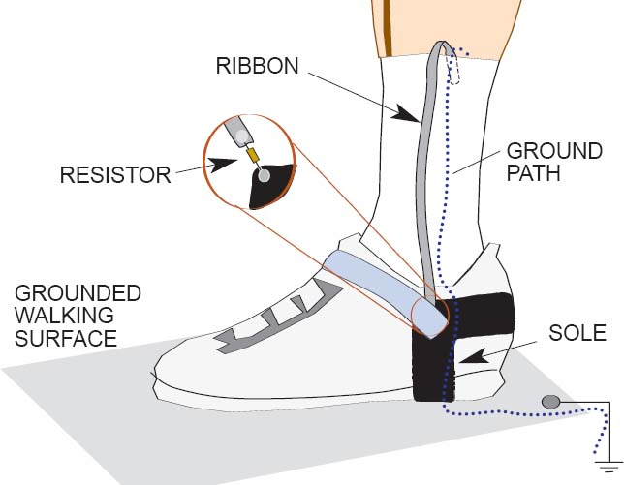
ESD Control: Grounding.
All conductors in the EPA must be grounded :
• You, your partners, jigs, work stations, etc…
Third prong on an outlet is ground (round port in socket)
Hard Grounding
• Direct to ground
• Dangerous for personnel and components
• Tables, shelves, etc...
Soft Grounding
• Through a 1MOhm resistor
• Safe for personnel
• Floor mats, work mats, wrist/foot straps
Basically you need to ensure electricity goes to ground (ground can be seen as some kind of “electrical purge”)

Slide 9
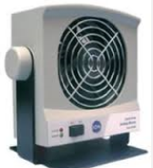
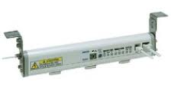
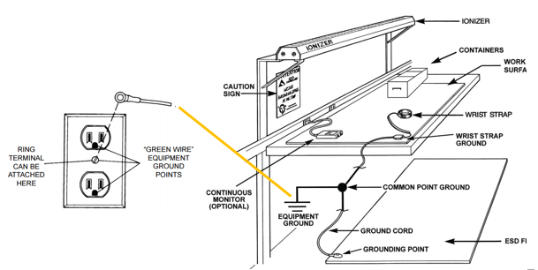

ESD Control: Workstation
• Two-Fold Purpose
– Provide a surface with minimal charge on it
– Provide a surface that will remove charges from conductors placed on the surface (such as sensitive electronics)
• A workstation must include:
– A ESD Work Mat
– Connection to a Common Ground
– Caution SIGN
– Ground cord
– Ground point
• Optional (but highly recommended):
– A ESD Floor Mat
– A Continuous Monitor
– A Wrist Strap (can be replaced for ESD gloves & ESD foot wear)
– A Wrist Strap Ground
Every Ionizer must be aiming towards the relevant electronics assembly area to ensure electric charge neutralization (it’s not a regular fan)

Slide 10
04
Identifying ESD daily at work
How does ESD usually takes place into an assembly process?

Slide 11


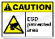




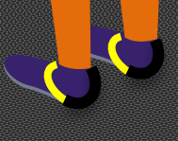



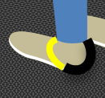
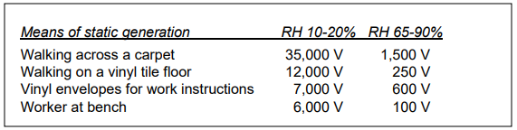
Work Station Grounding Importance
Required grounding points
This is where electricity flows through
- What happens when any or all of these fail?
I I
•
Ir
Ionizer
+
Ionizer
+
+
+
The operator will produce and accumulate electrostatic charge whenever he/she moves, until reaching such electrical potential leading to a electric tension (voltage) of over 2000 Volts.
+
+
+
+
+
+
+
>2000 V
+
+
+
+
+
+
+
+
+
500 V
+
+
After this point, depending on moisture or RH (Relative Humidity) and environmental conditions (shown below) a ESD occurs, which can be sensed by human body. We may observe that a high RH is safe for humans, but not so much for electronics.
+
100 V
+
Notice the usage of ESD conductive gloves at all times.

Slide 12
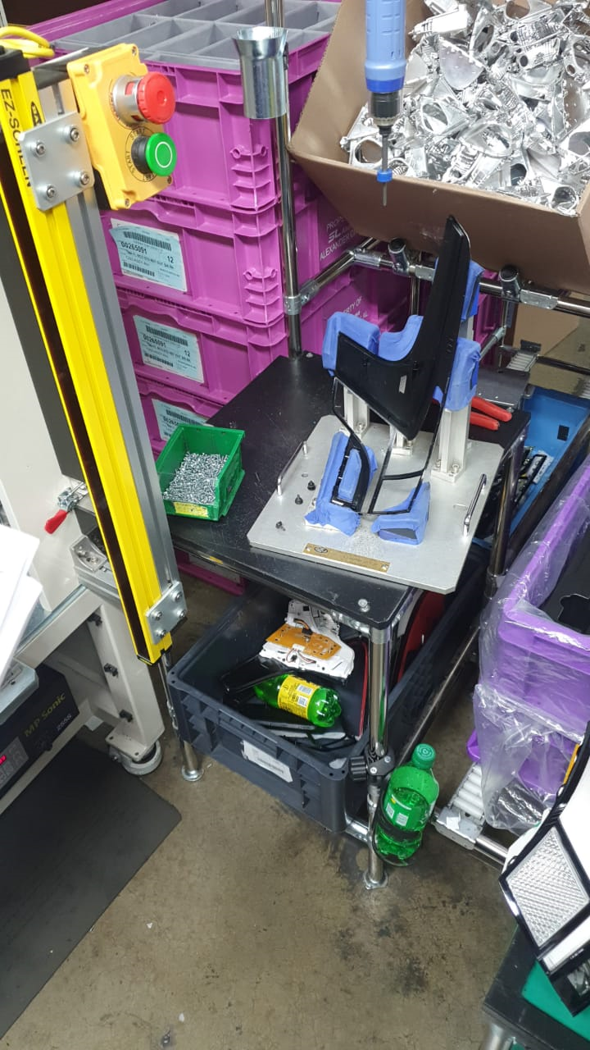
Common Grounding Issues.
Water bottles should NEVER be placed with any electronic/sensitive component (s).
I I
•
Ir
Ionizer
+
Ionizer
+
+
+
+
+
+
+
+
+
+
+
+
+
+
+
+
+
+
+
+
+
+
+
There’s no floor mat!

Slide 13
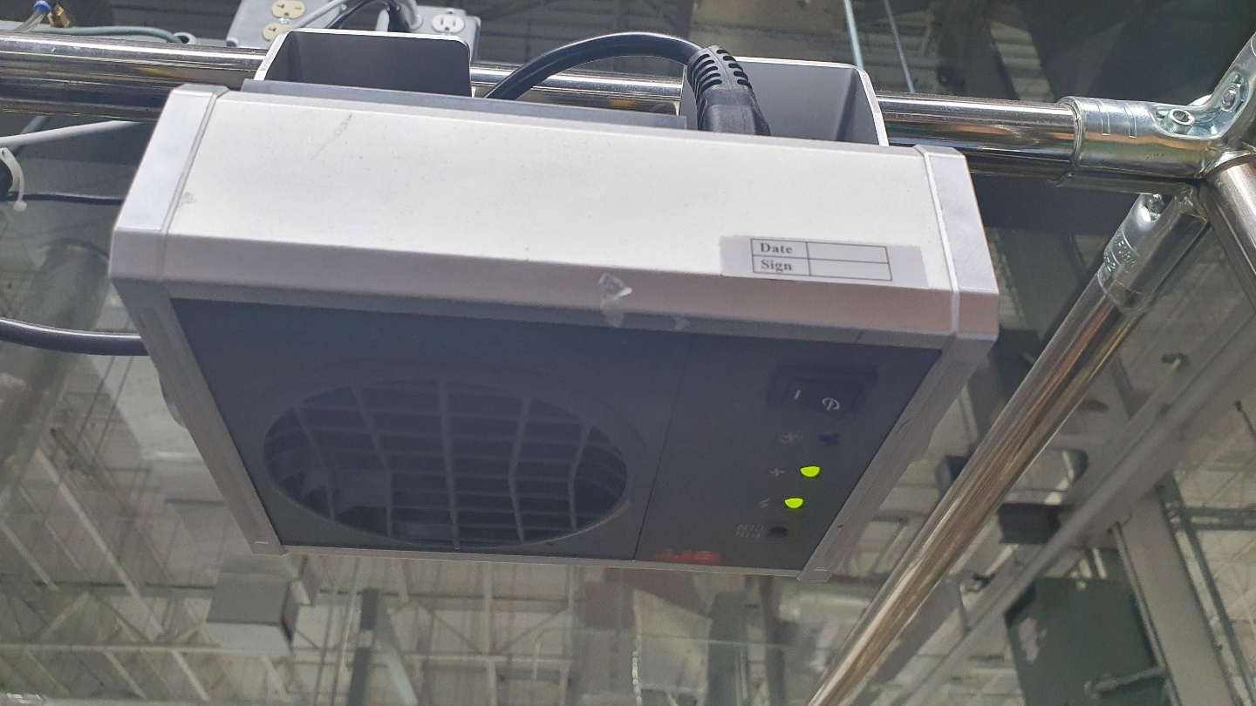
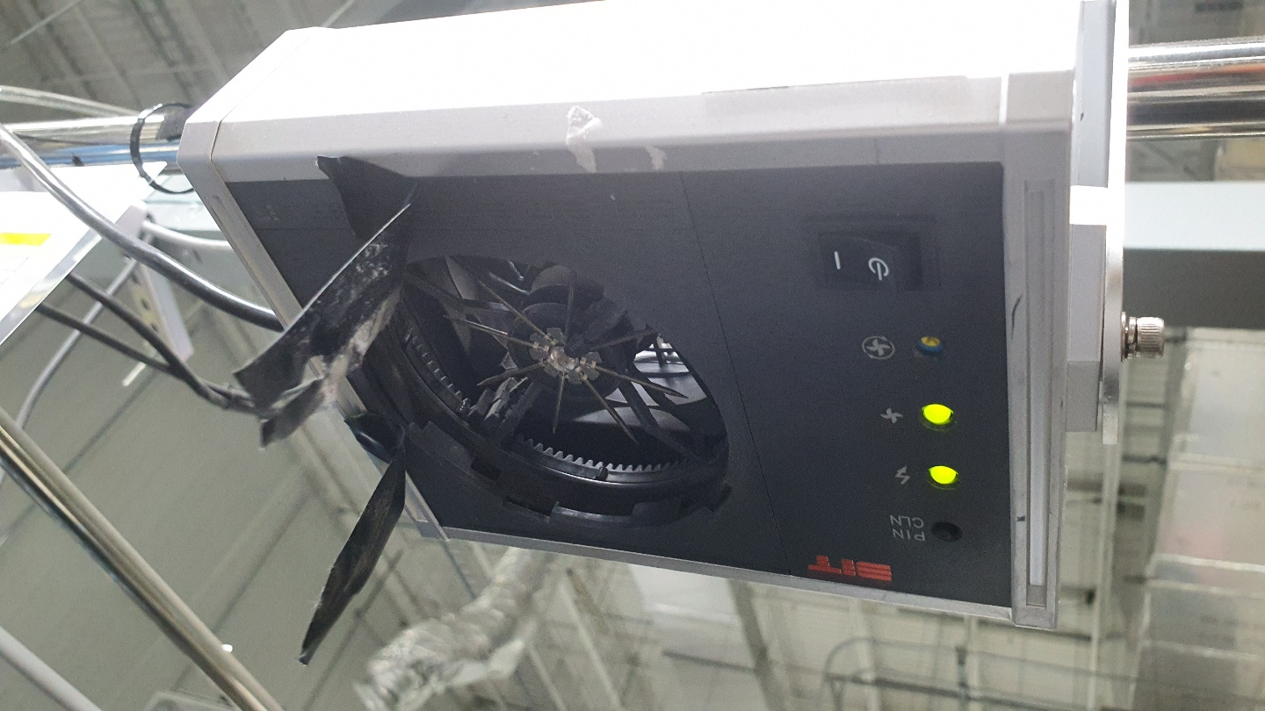
ESD Resistant Work Station: Ionizer (s)
Ionizers work to add negative ions into your work space, which attract and trap positively charged ions that are generated through your natural movement, in essence, one cannot avoid generating positive nor negative charged ions, but we can neutralize them to have a ESDS safe environment.
I I
•
Ir
Ionizer
-
+
-
+
+
Ionizer
+
-
-
+
-
+
-
+
+
+
-
+
+
+
+
-
+
+
+
+
+
Charge neutralization mechanism:
Opposite charges attract each other, just like magnet poles.
+
+
+1
0
-1
(+1 C) + (-1 C) = 0 C
Everything in nature, including electrostatic charges tends to equilibrium. (1 C = 1 Coulomb)

Slide 14
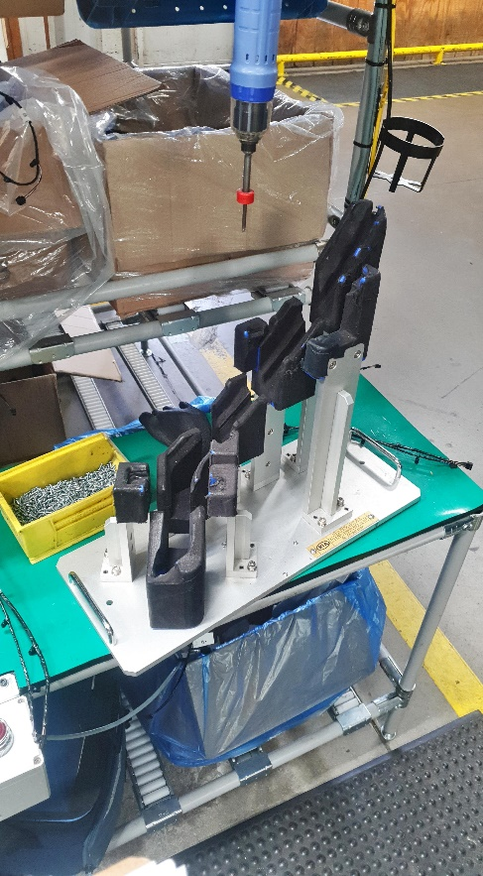
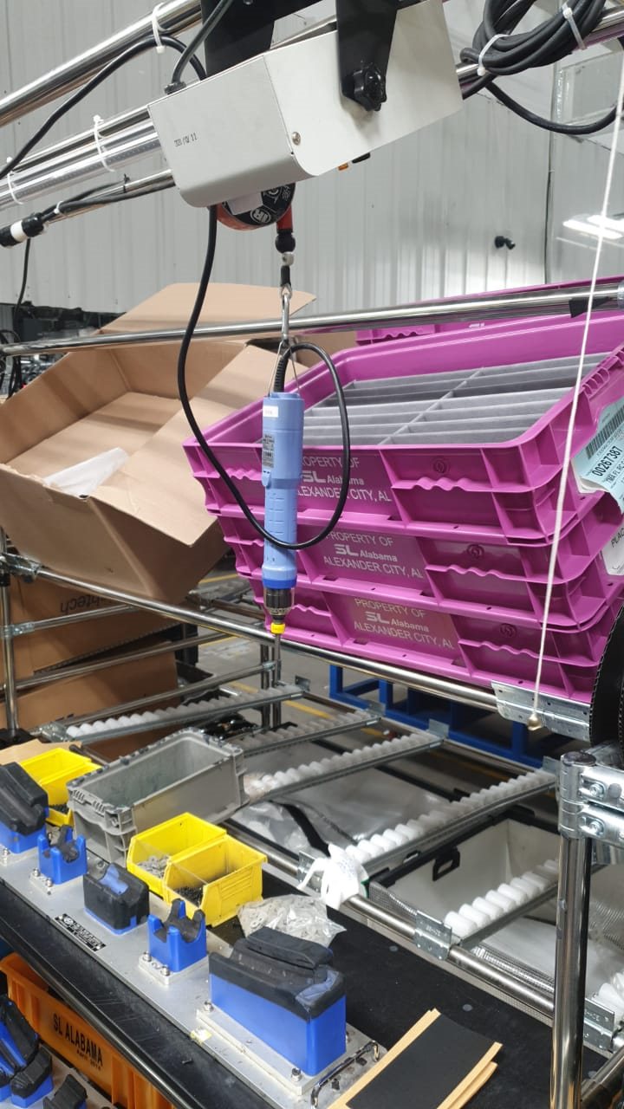
ESD Resistant Work Station: Working mat
The purpose of the ESD working mat/surface is two-fold:
To provide a surface with little to no charge on it.
To provide a surface that will remove Electrostatic charges from conductors (including ESD sensitive items (ESDS), devices and assemblies) that are placed on the surface.
I I
•
Ir
Ionizer
+
Ionizer
+
+
+
+
+
+
+
+
+
+
+
+
+
+
+
+
+
+
+
+
+
+
+

Slide 15
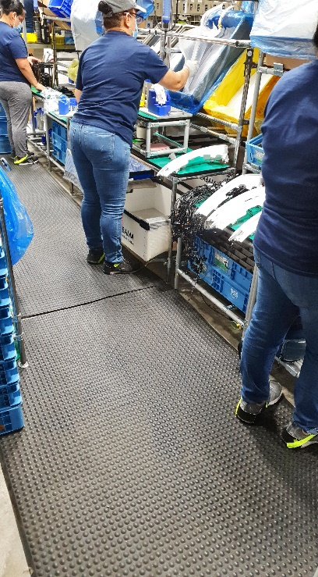
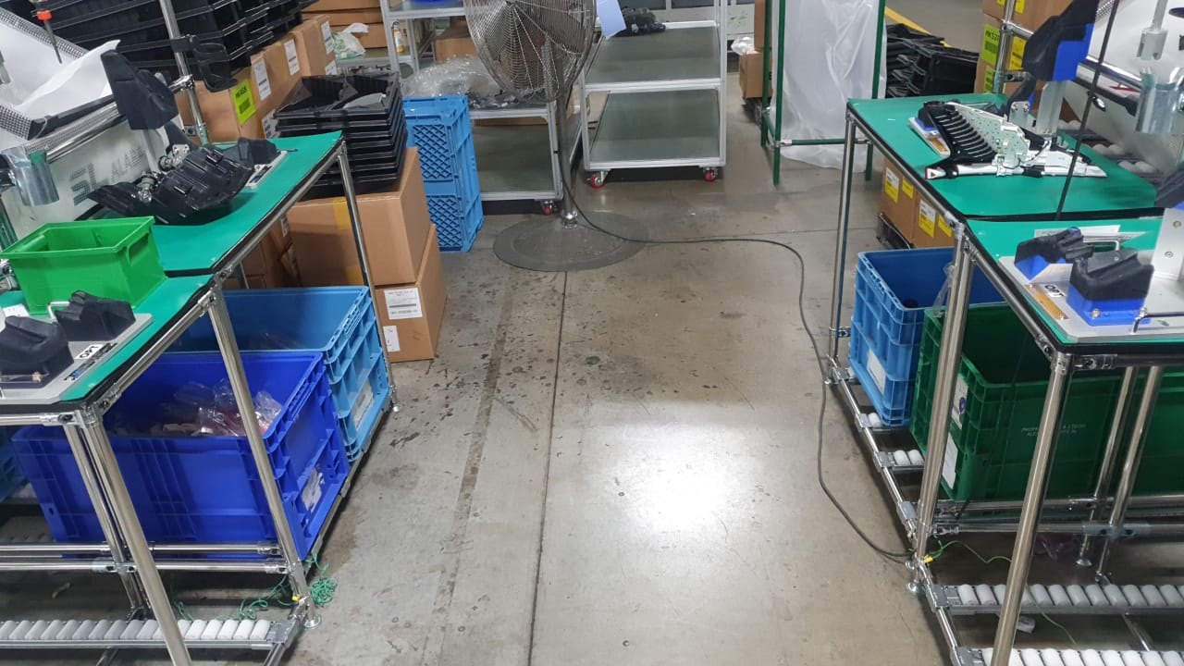
ESD Resistant Work Station: Floor matting
Floor matting is an essential component of the flooring/footwear system when grounding moving or standing personnel. The path to ground from operators via heel grounders to ground is maintained by using dissipative or conductive flooring.
Floor mats don’t just ground personnel; they are also used to ground ESD control items (e.g. mobile carts or workstations).
I I
•
Ir
Ionizer
+
Ionizer
+
+
+
+
+
+
+
+
+
+
+
+
+
+
+
+
+
+
+
+
+
+
+

Slide 16
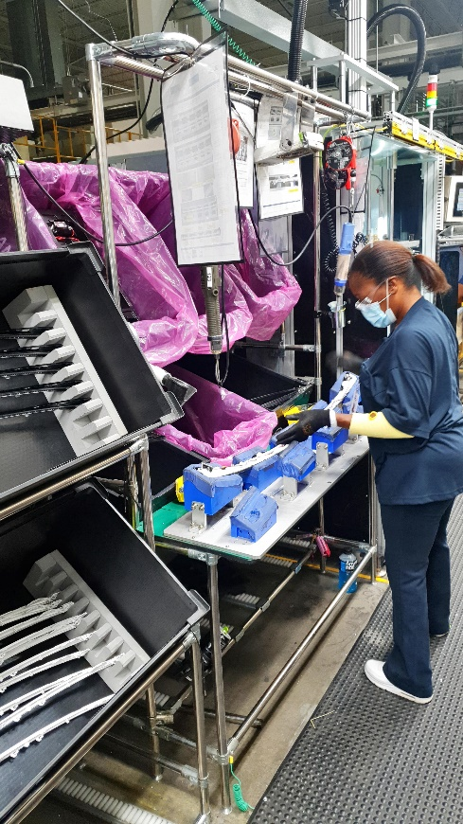
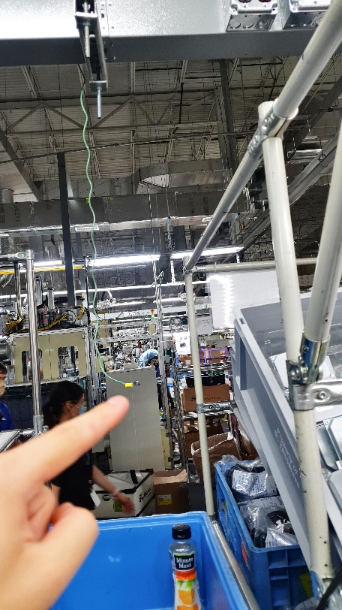


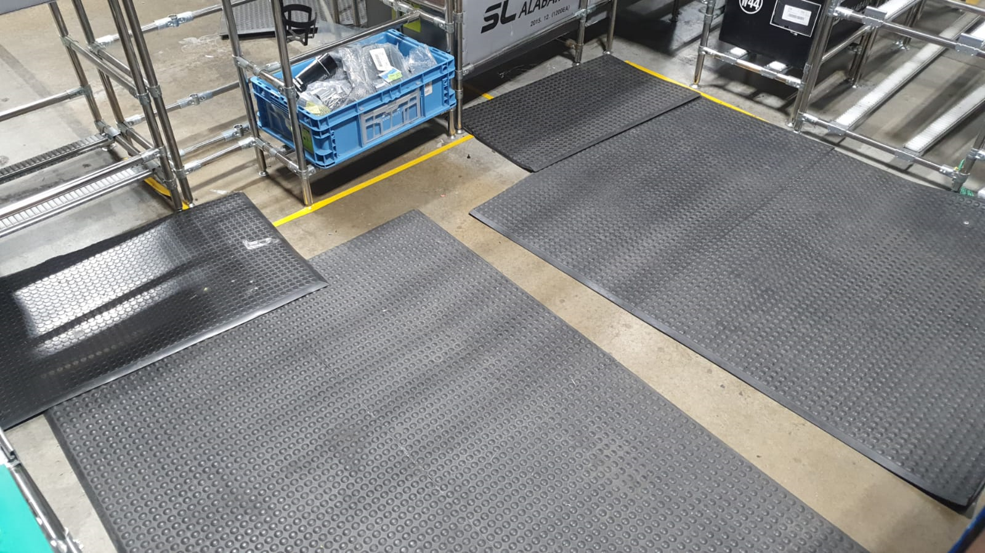

ESD Resistant Work Station: Floor mat grounding cord
Just like working surface matting, floor matting needs to be connected to ground. This ensures that any charges on the operator are dissipated through their heel grounders and the floor matting to ground. A floor mat grounding cord is used to link the floor mat to ground, alternatively, matting can be earthed via a strip of copper foil.
I I
•
Ir
Ionizer
+
Ionizer
+
+
+
+
+
+
+
+
+
+
+
+
+
+
+
+
+
+
+
+
+
+
+

Slide 17
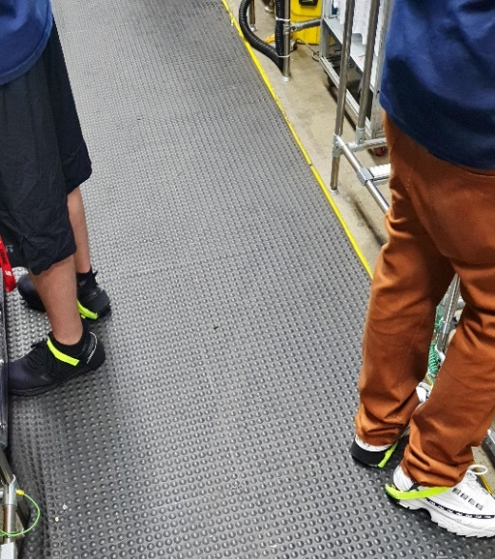
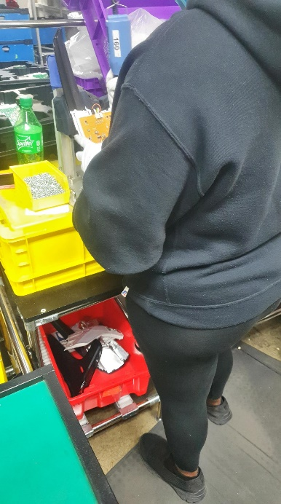
ESD Personal Protection Equipment (PPE): Foot Grounders
Foot grounders are designed to reliably contact grounded ESD flooring and provide a continuous path-to-ground by removing electrostatic charges from personnel. They are easy to install and can be used on standard shoes by placing the grounding tab in the shoe under the foot.
Foot grounders must be worn on both feet to maintain the integrity of the body-to- ground connection. Wearing a foot grounder on each foot ensures contact with ground via the ESD floor even when one foot is lifted off the floor. However, there’s a couple of parts that don’t contain any electronics at all, in that case a single foot grounder (shoe strap) is needed.
You must ensure a safe handling for electronic/sensitive components to avoid damage. Team Leaders must provide you two ESD shoe straps if you’re in touch with any ESDS. In this case we observe an operator with both missing ESD shoe straps handling a Printed Circuit Board (PC Board), which can lead to latent failure even though she’s wearing proper hand protection equipment.

Slide 18
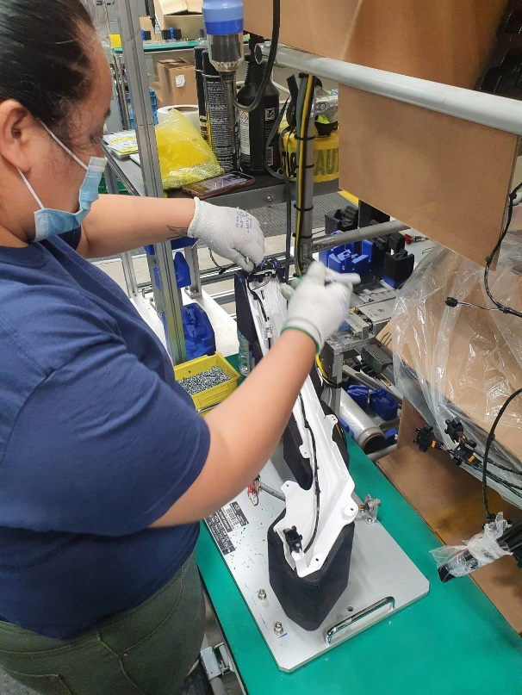
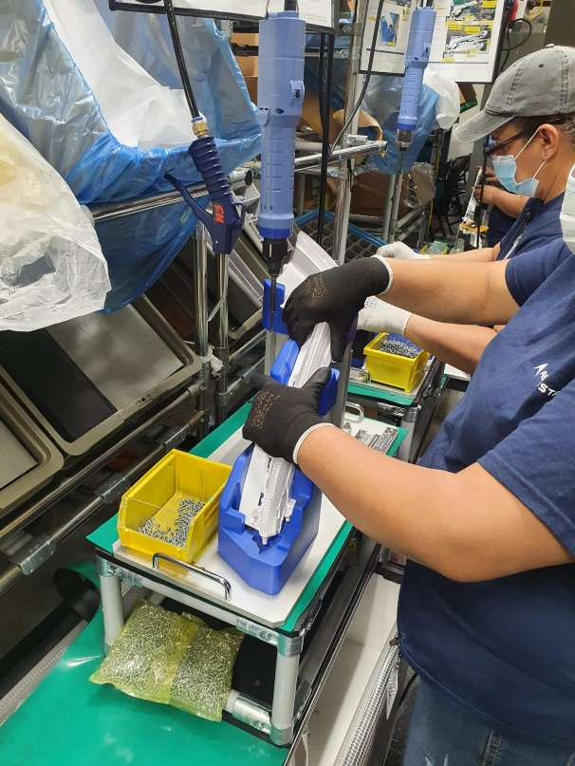
ESD Personal Protection Equipment (PPE): ESD Gloves
If you wear gloves, they should be sufficiently conductive so that their surface does not retain any charge, which gets discharged through you to your connection to ground (electric “zap” occurs). Conductive gloves will not work for ESD protection by themselves. They need to be used as part of a full system that includes getting you, your workstation, your tools and all components at ground potential, and keeping them there.
*Ground potential: The zero reference level used to apply and measure voltages in a system.
Cotton conductive gloves are great for you if you handle any electronics! (e.g. PC Boards, LDM’s, etc.)
I I
•
Ir
Ionizer
-
+
-
+
+
Ionizer
+
-
-
+
-
+
-
+
+
+
-
+
+
+
+
-
+
+
+
+
+
+
+
Rubber conductive gloves are better for not leaving any fingerprints and avoid scratch on non-electronic components(like lenses or housings, etc.)

Slide 19
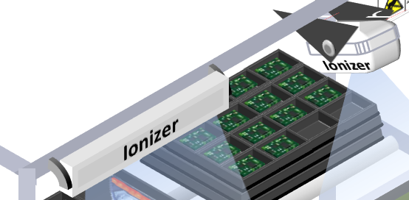

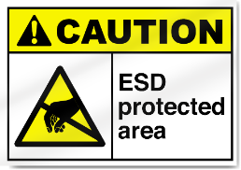
The Ideal ESD Work Station & PPE.
Ionizers
There’s at least one type of ionizer active and pointing to every jig/station/process that handles or involves electronic and/or sensitive components
Grounding
Connection to ground is properly done (in any of its forms) and ensures excess electricity is dissipated.
Signalization
The station has the corresponding signage in a visible place.
I I
•
Ir
Ionizer
-
+
-
+
+
Ionizer
+
-
Ground-station connection
Work station is connected to common ground correctly to dispose excess electricity.
-
+
-
+
-
+
+
+
-
+
+
Floor mat is present
-
+
+
+
+
+
+
Work mat
ESD work mat is present and has connection to the work station due to a screw/bolt contacting the station’s metallic frame, it is also neat.
+
+
+
+
+
+
Work mat- station connection
Work mat is connected to the station properly to allow excess charge flow through.
+
ESD Gloves
All operators are wearing their corresponding ESD gloves in good condition (black for non electronic and white for electric/sensitive components)
Floor mat-station connection
Floor mat is connected to the station firmly to allow electric charge flow to ground.
ESD foot/shoe straps
All relevant operators wear their foot protection correctly according to the component handled/assembled.

Slide 20
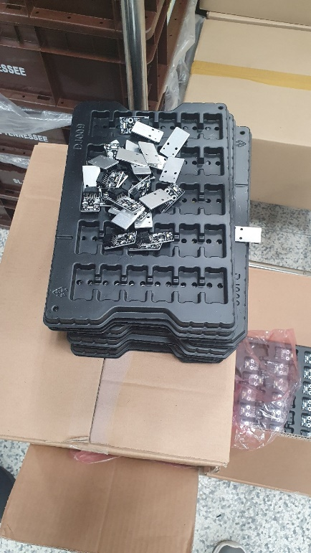
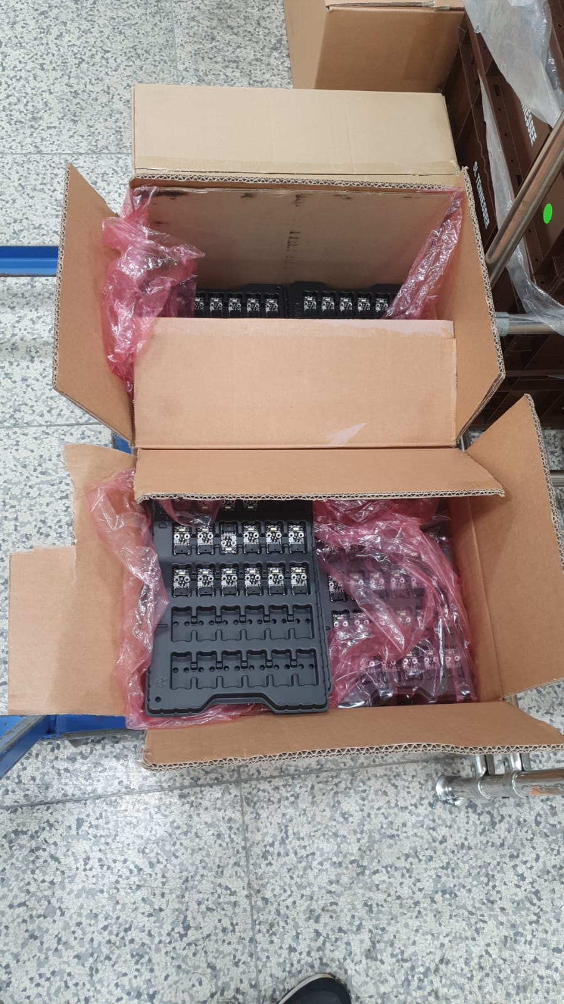
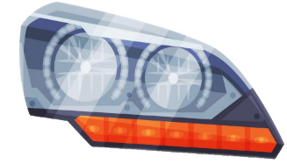
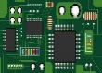
ESD Component Protection: Packaging/Stacking
ESD protective packaging is a way to prevent sensitive electronic components or any assembly that has one or more exposed circuits in them from getting “ zapped”, these bins, boxes, trays and special wrap are meant to dissipate electric energy from the components you work hard to assemble in the best possible way, which is why its important the product’s components are kept and handled safely.
ESD wrap
Component Stacking
Always make sure every component is stacked neatly in its corresponding place
ESD Box
ESD Box
A place for everything and everything in its place.
- Benjamin Franklin

Slide 21
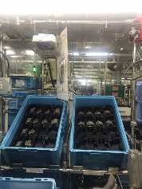
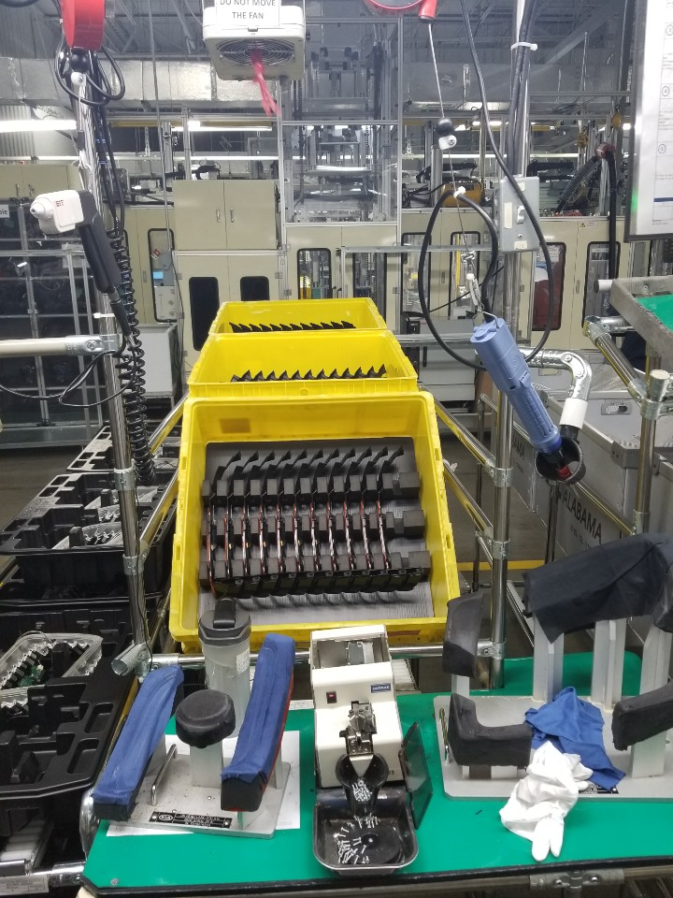
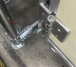
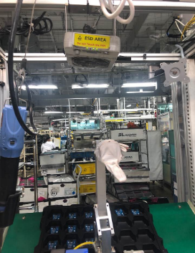
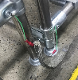
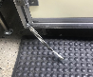
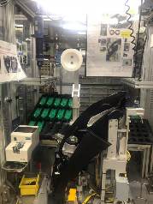
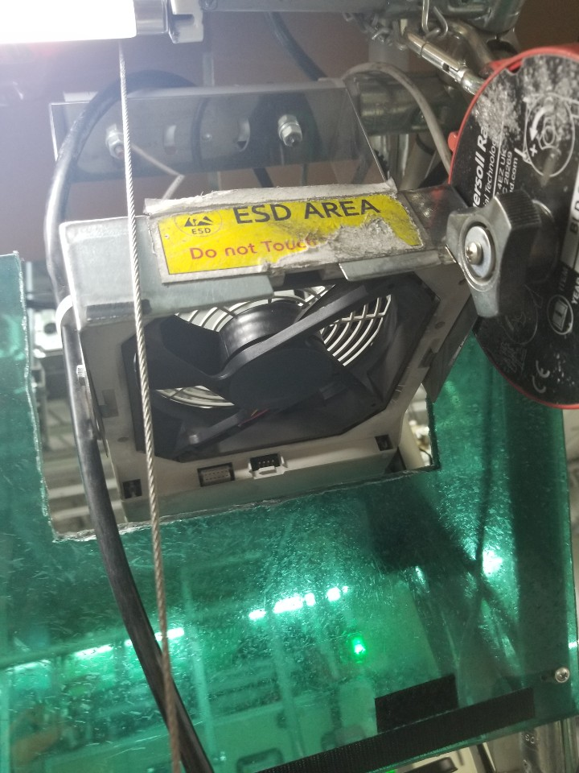
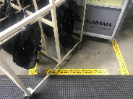
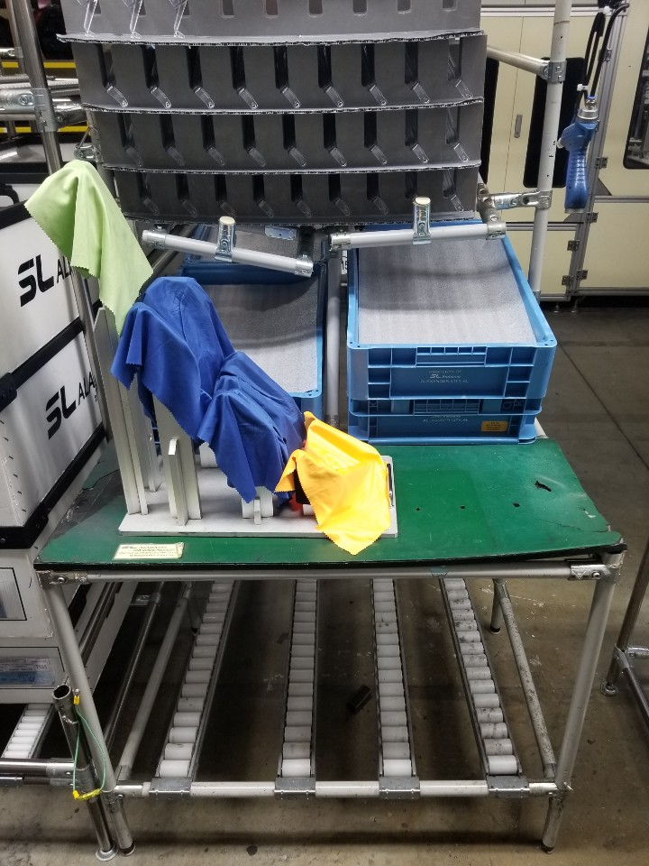
Common issues/flaws.
PICTURE | ISSUE | PICTURE | ISSUE
 | No antistatic box used for LED S/A. → The anti-static box must be used for electronic components. |  | Drink bottles are not supposed to be placed on the work stations. → They must be separated by at least 30cm from electronic components or removed from working station.
 | Invalid ground and disconnected → The ground must be connected to the main ground in series. Parallel grounding is not recommended. |  | Ionizer fan is not fixed and fan direction was towards the operator. → The fan must be directed to the electronic and not electric part assembly area
 | Missing an ionizer fan at a station where a LDM is handled and assembled. → The process of handling electronic components should always be neutralized by the ionizer. |  | The fan was broken or had a missing cover. The cover has the electrode, which allows ion neutralization. → It must be replaced for a new one by maintenance.
 | The EPA zone is not clearly distinguished. → EPA needs to be defined and clearly identified. |  | The mat was not connected to the ground. → This way electricity cannot flow through the station to ground.

Slide 22
How am I related to ESD?
Although most personnel has assigned assembly line duties, some other workers may not be entirely in contact with ESD sensitive components such as Team Leaders, Corporate, Managers, etc.… If you fall in any of these categories you may be wondering what can you do to help minimize these events, which is the following:
What can Manager and Team Leader do for ESD management?
1. Shoe straps
- Check the workers are correctly worn on both feet.
- Check the wear of the heel strap on all process workers handling electronic components.
2. Ionizers
- It is necessary to verify that the operation is performed with the ionizer on.
- Need to make sure that the direction of the ignitor is towards the product which is assembled with
electronic component.
- To maintain ESD performance, periodic cleaning of the electrode pin is required once a week.
3. Grounding
- It is necessary to verify that the operation is performed with the ionizer on.
- Need to make sure that the direction of the ignitor is towards the product which is assembled with
electronic component

Slide 23
THANK YOU

